Slide 1
Let us do Kubernetes Monitoring
along with AI-powered Observability!

Slide 2
Agenda
Prerequisites
Monitoring and Observability
Prometheus, Grafana, Kubernetes
Logging, Tracing
eBPF
AI aspects on Observability

Slide 3
Prerequisites
Linux machine/virtual machine up and running. In case, this is not available, setup one using oracle virtualbox through below links
Ubuntu virtual box setup : https://docs.google.com/presentation/d/1ye0CZ88YaCU1OJycSjtQ1j4LaRxayIic/edit?usp=share_link
Virtual machine creation: https://drive.google.com/file/d/1CfJ4XrtSFmZFgflBKn6cCdvEWhwxVKrF/view?usp=share_link
The Kubernetes cluster ready. If not available, setup one using kind:
https://kind.sigs.k8s.io/docs/user/quick-start/

Slide 4
Monitoring v/s Observability

Slide 5


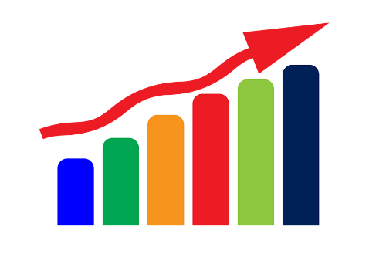
Monitoring
Collect specific or predefined system information continuously to provide the overall system health information. It can also give information to take specific corrective actions
Watch the system for specific system information
Need to ask for specific info to get!
Get ‘known’ unknowns!

Slide 6

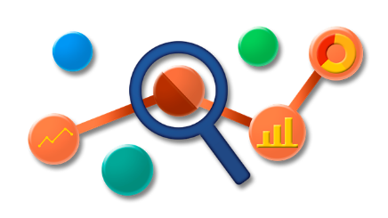
Observability
Just based on the outputs from the system , describe the behavior of the system completely
A system is said to be observable if, for every possible evolution of state and control vectors, the current state can be estimated using only the information from outputs
Insights in to the system behavior
Derive the behavior of the system (not the specific info asked)
Get ‘unknown’ unknowns!

Slide 7
Observability: Let us understand a bit more..

Slide 8
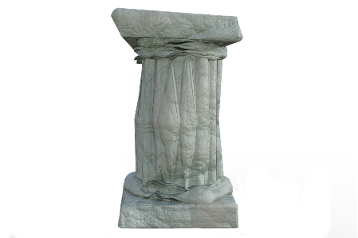
Effective observability depends on how well the internal states are inferred from its external outputs
3 Pillars of Observability
In a way Monitoring is already included in Observability
Metrics, Logs and Tracing are key system information used by Observability.(not limited to!)
Effective observability solutions take all possible system outputs to get deeper insights on the system
Metrics
Logs
Tracing
Illustration:
Just consider metrics in monitoring – Monitor some metrics and once it cross thresholds, give alerts
The same in case of observability – high cardinality metrics with huge system information to infer deeper insights. Not just a particular set of anomaly in the values.

Slide 9

Observability gives e2e deeper performance bottlenecks and insights
Uses all possible states and patterns based on the system outputs
Faster identification of issues and optimization
Suitable for Dynamic and complex systems (like distributed cloud native applications, distributed microservices…)
With real time deeper system behavior insights, supports effective automation of resolutions
Dynamic Determination of the entire system behavior
Illustration:
In monitoring – Usually you pre-configure info you need where you anticipate the possible issues that could arise. It can give alerts only based on that.
But, Cloud native / Distributed complex container application deployments, you are not sure what kind of problems that can arise! In such cases, you need all possible insights to get the unknowns.

Slide 10

Hard to anticipate the types of issues in modern applications. Hence, deeper system behavior insights are critical.
More complex pipelines of DevOps & AIOps needs information beyond predefined data monitoring for smooth ITOM
Effective observability can discover new issues and system behavior continuously and automatically. This is critical for the best service quality, customer experience and hence business continuity.
Enables SRE Teams for more secure and resilient software deployments
Effective Resource Management in highly scalable deployments (like multicluster Kubernetes deployments.
Make the software solutions more cost effective
Why observability is important?

Slide 11

Source Silos : The source of data source are scattered and building single source of truth is hard
Observable System Design : The system needs to be designed as observable and many systems lack right instrumentation for effective observability solutions
Too Many Tools : too many tools, incompatible interfaces and hard to build inter dependencies of the data
Huge volume : The volume of raw data collected is huge (and growing exponentially)
Unstructured Data : Processing demand is on unstructured data. Also the variety, velocity and complexity are very dynamic
This Photo by Unknown Author is licensed under CC BY

Slide 12

For effective e2e Observability:
We need Single Source of Truth (SSoT)
Bring consolidation of distributed & scattered data source through SSoT interfaces
Unified Observability Tools
Right AI/ML modules, 100% Automation

Slide 13

Cloud Native Project Landscape for Observability & Analysis is Growing!

Slide 14
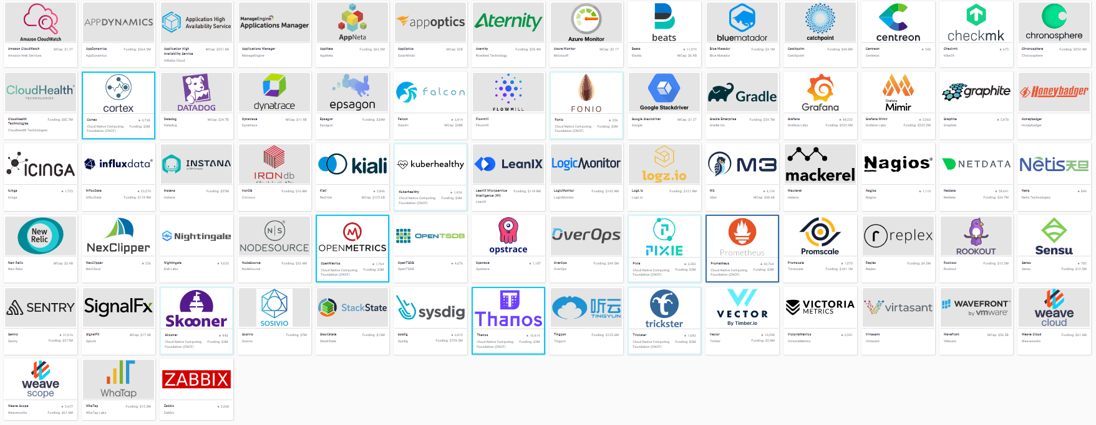
Observability & Analysis : Monitoring

Slide 15
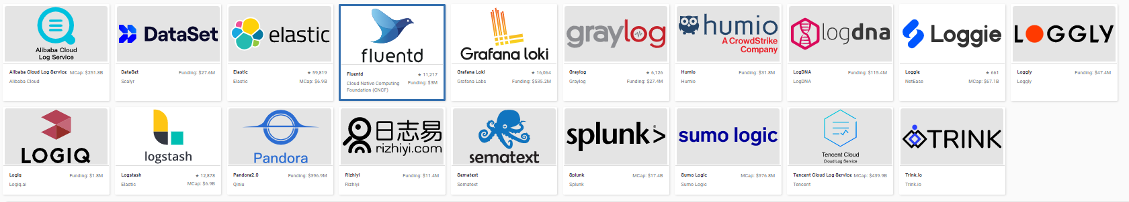
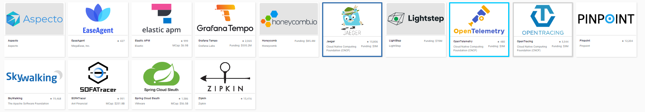
Observability & Analysis : Logging
Observability & Analysis : Tracing

Slide 16
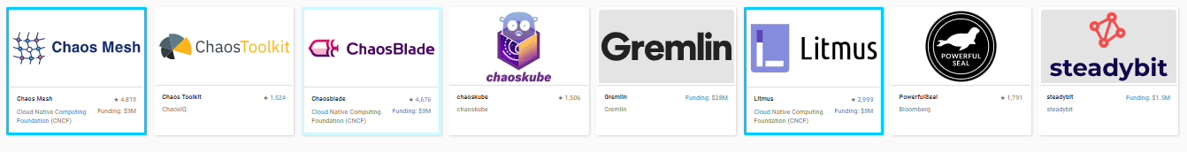
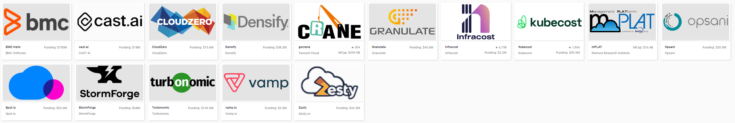
Observability & Analysis : Chaos Engineering
Observability & Analysis : Continuous Optimization

Slide 17
Large number of projects are getting in to the CNCF Observability & Analysis Project Landscape.
(Open Source and Proprietary)
This points the criticality of observability, challenges and opportunities!

Slide 18
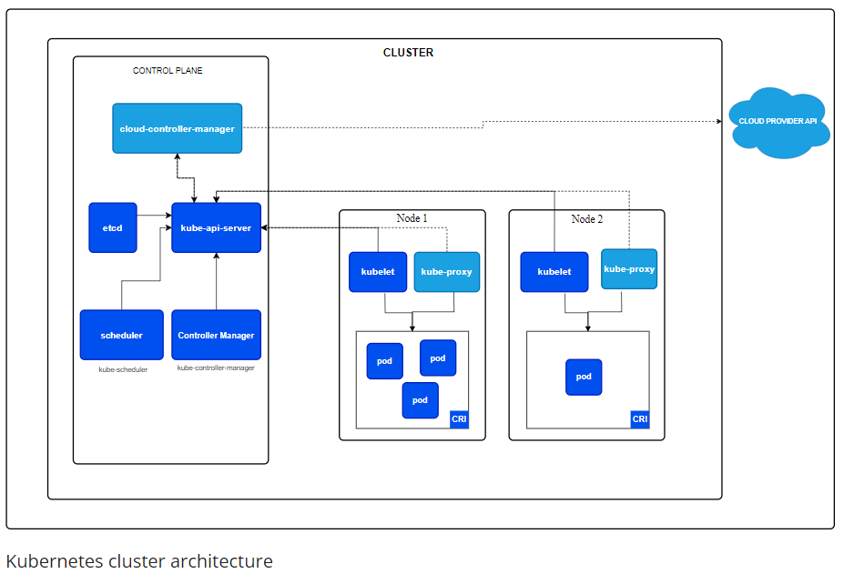
Kubernetes Introduction

Slide 19
Why need Monitoring
Pods are ephemeral
Workload scheduling is dynamic based on different factors
Cluster nodes can go down and come back
Kubernetes system detects the faults and does best to recover application, hence critical fault can go unnoticed

Slide 20
Hands On : Logging
Deploy a sample application (wordpress here)
helm repo add bitnami https://charts.bitnami.com/bitnami
helm repo update
helm install wordpress bitnami/wordpress
Checking application level loggings
kubectl logs wordpress-mariadb-0
kubectl logs wordpress-mariadb-0 -f
kubectl logs wordpress-mariadb-0 --tail=2
Checking logs from nodes
kubectl get pods -o wide
docker ps -a | grep kind-worker2
docker exec -ti <Container Id>/bin/sh
cd /var/log/containers
cat <container-log.log>

Slide 21
Metrics with Prometheus
Metric collection from HTTP scrape targets
Applications provide /metrics endpoint
Service discovery for cloud native (container) environments
Strong PromQL which is a rich query language
Own time-series database as backend

Slide 22
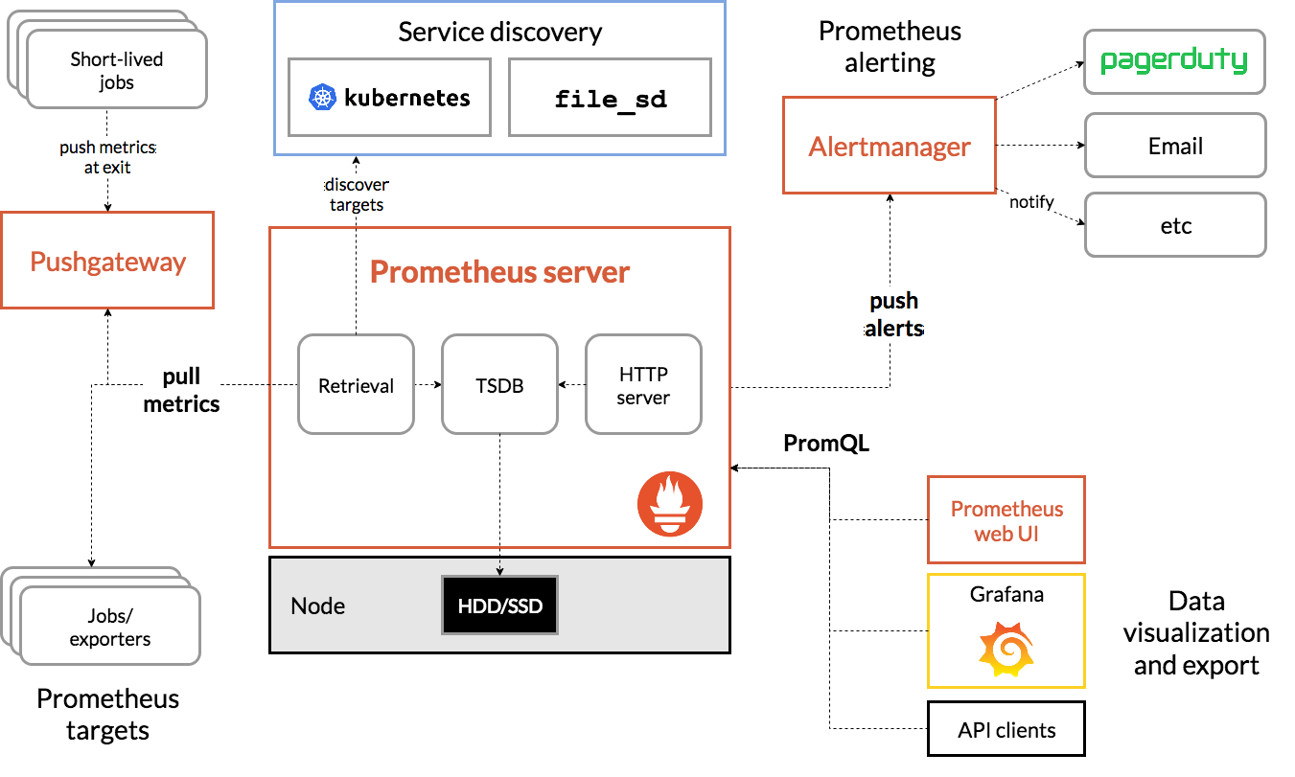
Prometheus Architecture

Slide 23
Hands On : Prometheus Deployment
Helm :
helm repo add prometheus-community https://prometheus-community.github.io/helm-charts
helm repo update
helm install workshop prometheus-community/prometheus
What and Why

Slide 24
PromQL
# Latest sample
metric_name
# Range
metric_name[5m]
# Labels
metric_name{label1=”a”,label2=”b”}
# Functions
rate(metric_name[5m])
sum(metric_name)
delta(metric_name[5m])
# Comparisons
metric_name > 10*1024
Prometheus provides a functional query language called PromQL (Prometheus Query Language) that lets the user select and aggregate time series data in real time.
The result of an expression can either be shown as a graph, viewed as tabular data in Prometheus's expression browser, or consumed by external systems via the HTTP API.”

Slide 25
Service discovery
Lots of moving targets
Auto-scaling VMs in the cloud
Services run in containers, orchestrators shuffle workloads
Microservices and serverless apps
`scrape_config`
Dynamic list of targets
Service Discovery
Prometheus
Monitoring Targets

Slide 26
Metrics
Cluster metrics
Node status, resource usage
Deployments, no of pods
Pod metrics
Kubernetes, containers, applications
So many metrics …

Slide 27
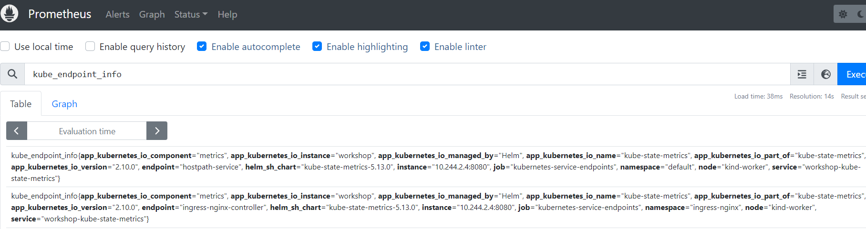
Prometheus UI
..

Slide 28
Grafana Introduction
Grafana is open source visualization and analytics software. It allows you to query, visualize, alert on, and explore your metrics no matter where they are stored. In plain English, it provides you with tools to turn your time-series database (TSDB) data into beautiful graphs and visualizations.
Grafana needs external data sources
Graphite, InfluxDB, Prometheus
MySQL, Elasticsearch, ...
Dashboards as overview
Panels as building block with Query builder

Slide 29
Hands On : Grafana setup
Helm:
helm repo add grafana https://grafana.github.io/helm-charts
helm install grafana-workshop grafana/grafana

Slide 30
Tracing
Creating a cluster
Storage configuration
Detailed configuration
Agent Strategies
Remote sampling

Slide 31
Getting Started
Yaml: https://github.com/jaegertracing/jaeger-operator/releases/download/v1.49.0/jaeger-operator.yaml

Slide 32
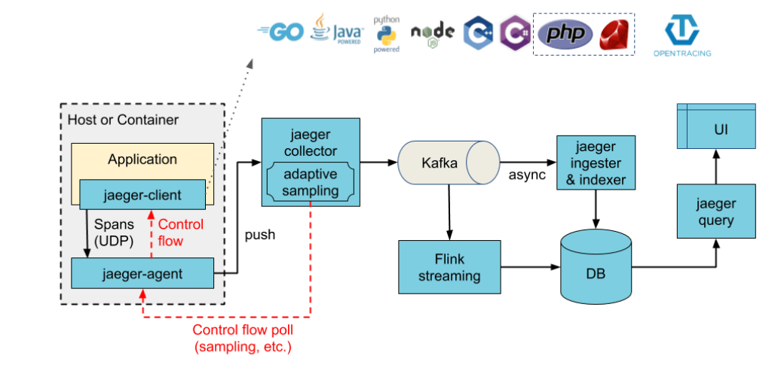
Jaeger architecture with Kafka

Slide 33
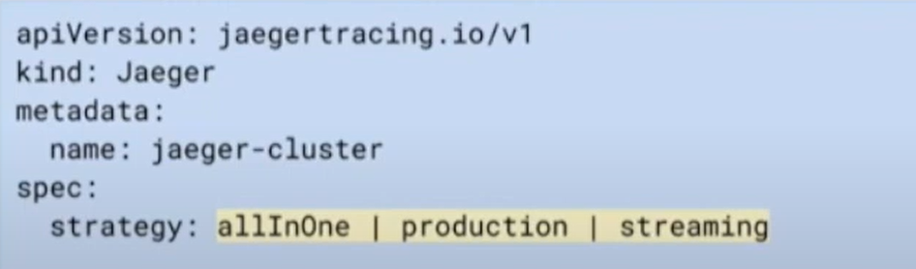
Creating cluster
CRD - Custom Resource Definition

Slide 34
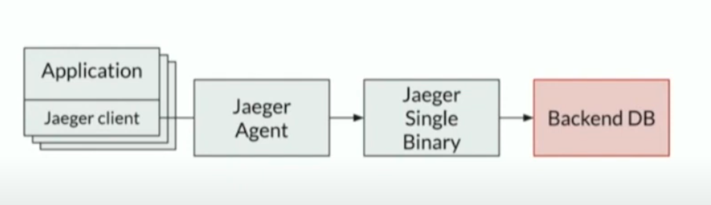
Strategies: allInOne

Slide 35
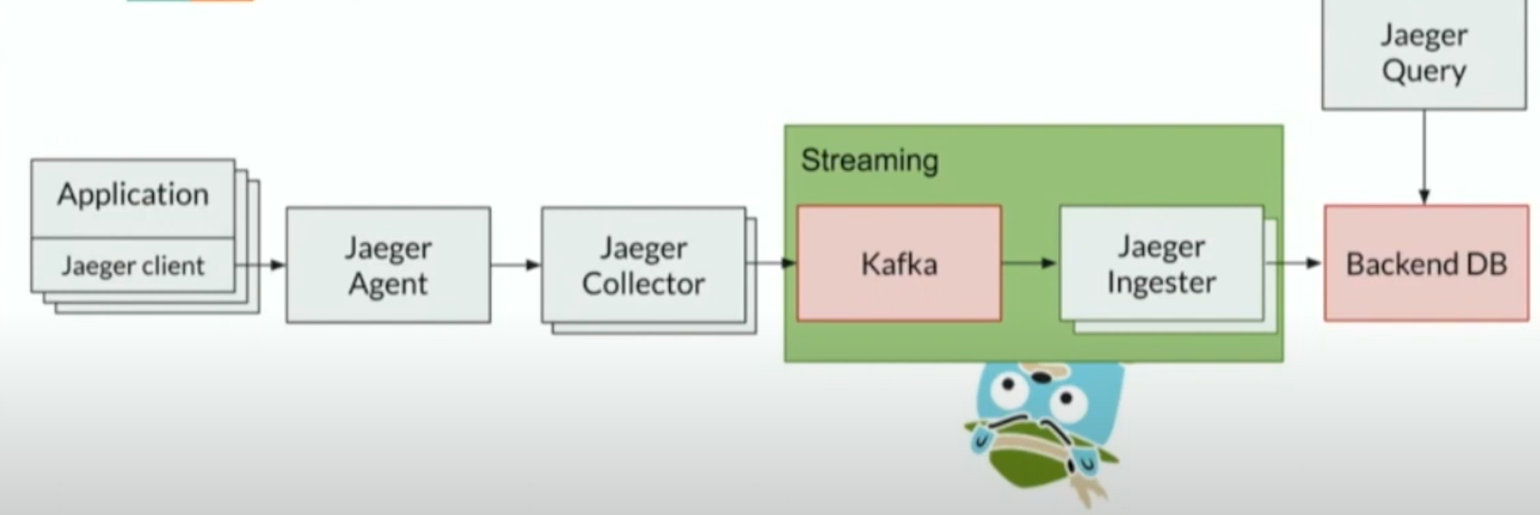
Strategies: Production/Streaming

Slide 36
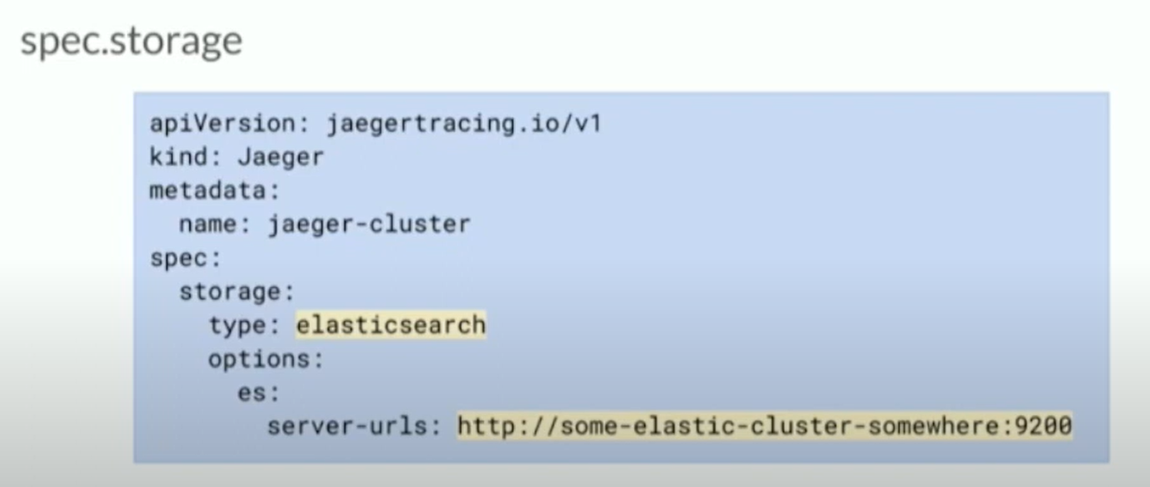
Storage configuration (beckend)

Slide 37
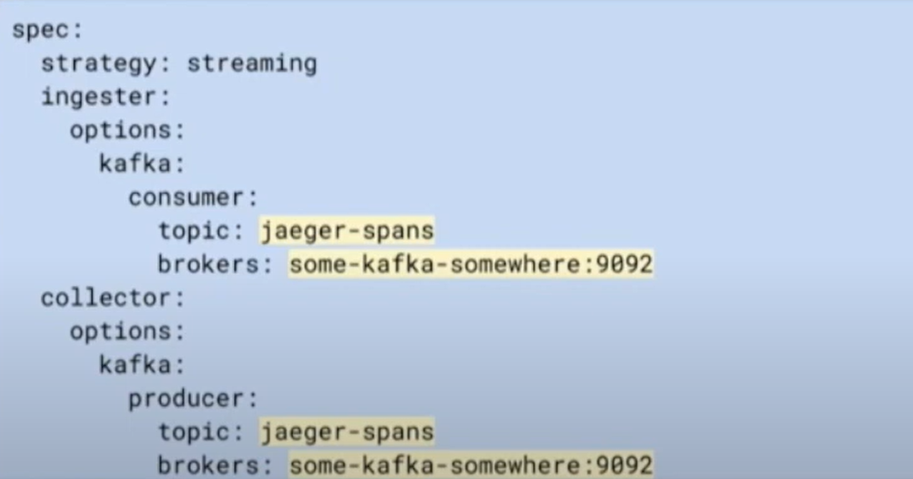
Storage Configuration (kafka)

Slide 38
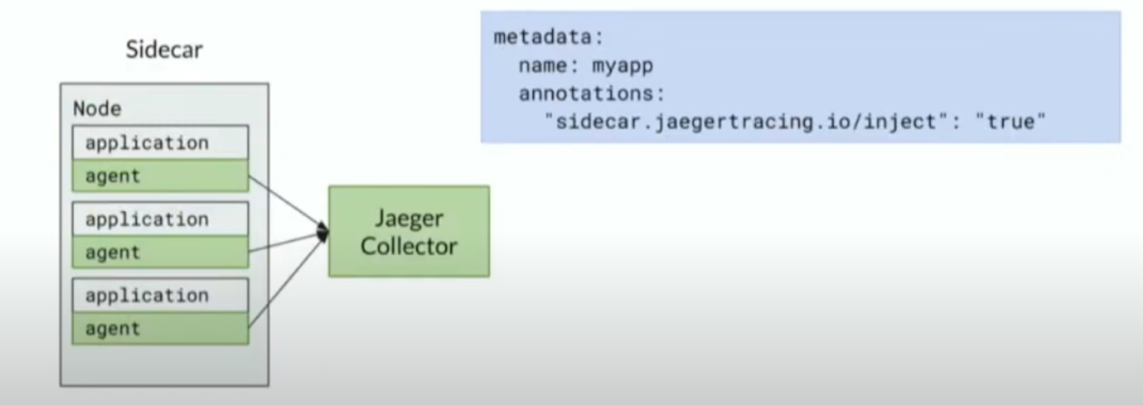
Agent Strategy (Sidecar)

Slide 39
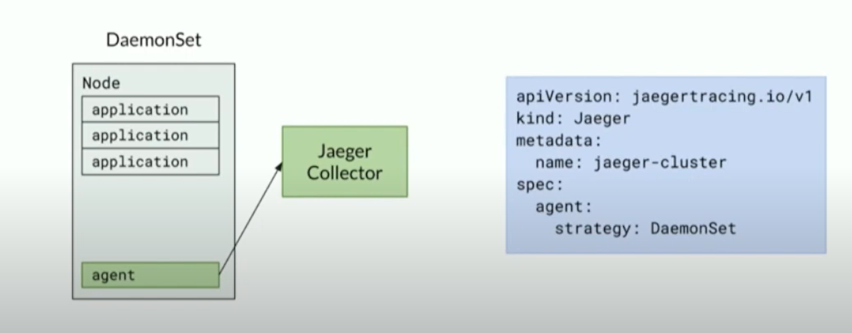
Agent Strategy (DaemonSet)

Slide 40
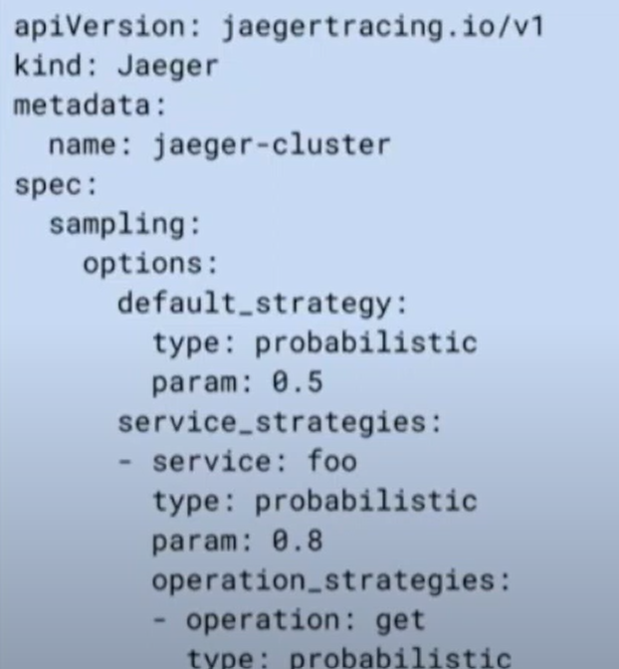
Remote Sampling

Slide 41
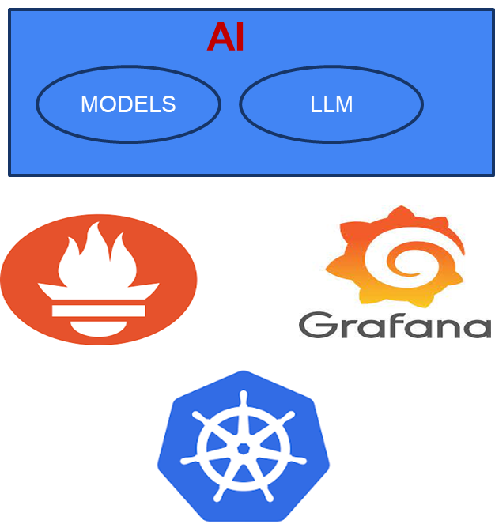
AI with Monitoring

Slide 42
Thank You!
info@cazelabs.com

